Slide 1
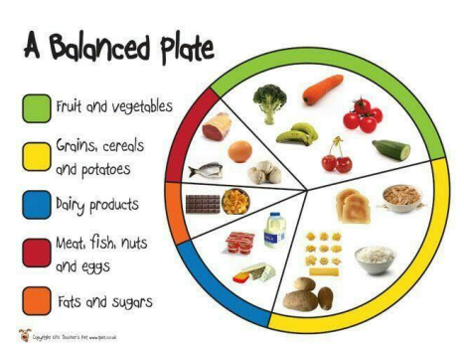
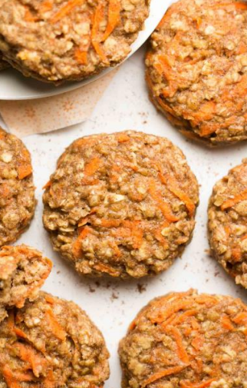
Year 1
Cooking and Nutrition
DT Knowledge Organiser
Key Knowledge and Skills | Evaluate | Vocabulary
Cut, peel and grate ingredients safely and hygienically. | Would I change any ingredient and why? | Hygiene | Keeping clean and healthy and free from germs.
Measure and weigh using measuring cups or electronic scales.
 |  | Fruit | Grows on plants and contains the seeds. Part of a plant that people eat.
 | Which ingredient did I like the most?
Assemble or cook ingredients.
 |  | Vegetable | Part of a plant that people eat.
Understand the food hygiene procedure before cooking – clean and tidy cooking area, wash hands, remove jewellery. Put on an apron, tie back long hair.
 |  | Recipe | A list of ingredients and instructions for preparing and cooking food.
 | Could I mix, peel, grate and cut safely?
Understand the food hygiene procedure after cooking – clean down surfaces, put ingredients away, wash equipment and dry equipment.
Understand the food hygiene procedure after cooking – clean down surfaces, put ingredients away, wash equipment and dry equipment. |  | Scales | Machine for weighing things.
 |  | Vitamins | Substances that are found in foods that the body needs to keep healthy.
 | Would I slice or prepare any of the ingredients differently next time?
Use peeler, grater and knife safely.
Understand the food groups. |  | Balanced diet | Diet which has all of the right kinds of food for being healthy.
 | If I could change or add an ingredient to my biscuit what would it be and why?
Evaluate their ideas against a design criteria that has been created as a class.
 |  | Grater | A kitchen utensil with sharp holes.
Outcome – To
follow a recipe
to make healthy
carrot cookies for
harvest festival.

