Slide 1
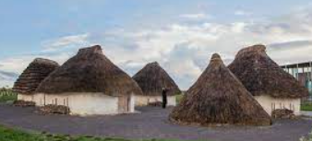
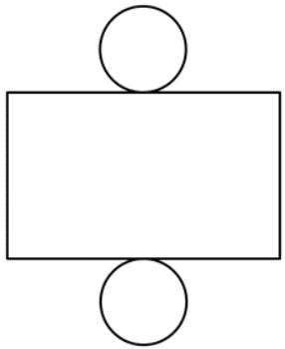
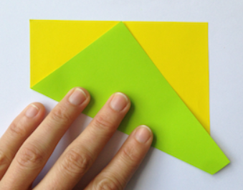
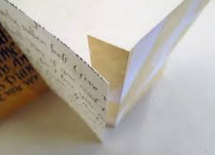
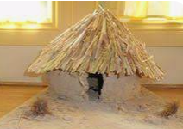
Year 3
Structures and Mechanisms.
DT Knowledge Organiser
Key Knowledge and Skills | Evaluate | Vocabulary
To use a given design criteria to inform your design. | What do you like about the home? How well has it been made? What materials have been used? Is it fit for purpose? (Show an existing product) | Structure | A building or other object constructed from several parts.
To generate realistic ideas, focussing on the needs of the user.
 |  | Shell Structure | A 3 dimensional solid structure.
 | What went well with your design?
To describe the purpose of their product.
 |  | Style | The appearance by which it is designed.
To share and clarify ideas.
 |  | Durable | Able to withstand pressure or damage. Needs to be hard wearing.
 | Would you change anything? Why?
To select suitable materials and tools which are fit for purpose.
Understand the food hygiene procedure after cooking – clean down surfaces, put ingredients away, wash equipment and dry equipment. |  | 3D Net | The net of a 3D shape is what it looks like if it is opened out flat.
 |  | Tabs | A small flap or strip of material attached to hold, fasten something in place.
Begin to measure, mark out and cut the shapes needed. | What did you find challenging? Why?
Begin to assemble, join and combine the materials chosen. |  | Folding/ Layering | To bend paper or material in a certain way. Layer things on top of one anther.
 | Do you like your finished home? Why?
To use a range of finishing techniques with some accuracy.
 |  | Corrugating / Ribbing | Shape into parallel ridges and grooves.
Outcome – To design and
make a Neolithic home.
tab

