Slide 1
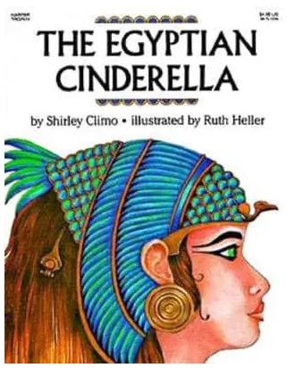
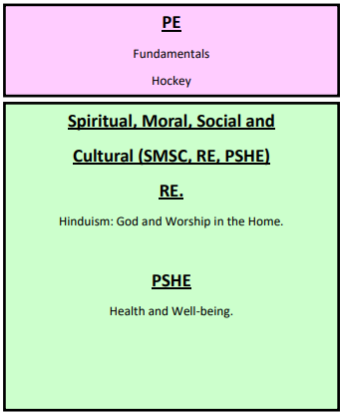
Year 3
Summer Term (A)
What were the achievements of the Ancient Egyptians?
Humanities.
Geography, History, Global Learning.
The children will look at different ages, or periods, of the Egyptian Age. They will locate Egypt on a map and look at surrounding countries that the Empire expanded to. They will also look at the River Nile and why it is important. The role of farming in Egypt and techniques which were important will be explored. For example irrigation and how the River Nile was involved. We will compare this to prehistoric farming? The children will investigate hieroglyphics and how the Rosetta Stone was important for archaeologists in deciphering what was written in Hieroglyphics. They will understand the role of the pharaoh in Egyptian society and how their lifestyle compared to civilians. The children will investigate the Pyramids and the Valley of the Kings to understand what these landmarks tell us about the Pharaohs.
We will look at the role of archaeologists in understanding the Egyptians through the role of Howard Carter discovering the tomb of Tutankhamun.
Key dates for your Diary.
Trip to the Gurdwara – 19.04.24.
The Great North Museum – TBC.
English.
Egyptian Cinderella. (Traditional Tale)
Children will produce diary entries retelling the story from different character’s points of view.
Egyptian Cinderella. (Non Fiction Radio Report.)
Children will create a radio news report about events in the book.
Poetry. (A range of poems)
Children to create a short commentary about a chosen poem to explain why people should read it.
Art and Design Technology
Art.
Artist Study. Laurie Hastings - Printing using their own printing block to create two colour prints. The children will complete other pieces of art around the Egyptians.
Design and Technology.
Design and make a decorated cushion for the Egyptian queen Cleopatra. (C/C History)
To cut out shapes using scissors by pinning and cutting around a template.
To show an understanding of seam allowance.
To be able to join fabrics using a range of stitches, including, running stitch, back stitch and over sewing.
To decorate fabrics using resist methods such as tie-dye and printing through heat transfer.
Maths.
Measurement: Money (2 weeks)
Measurement: Mass and capacity. (3 weeks)
Measurement: Time. (1 week)

