Slide 1
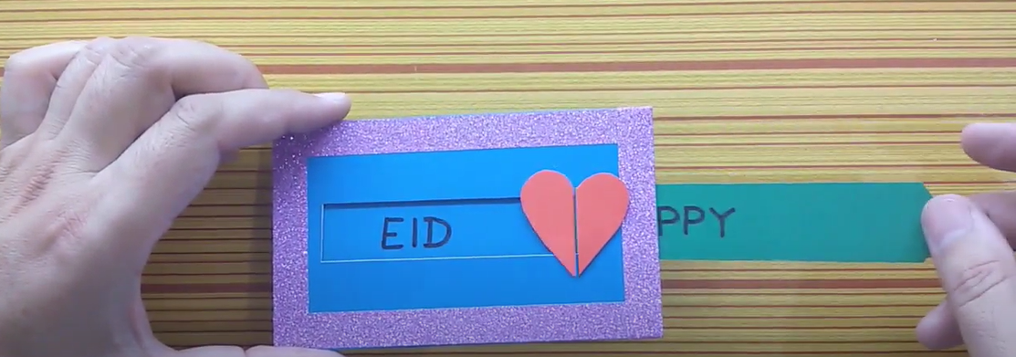
Year 1
Structures and Mechanisms
DT Knowledge Organiser
Key Knowledge and Skills | Evaluate | Vocabulary
Have some of my own ideas. | What did I like about my product? | Mechanism | A system of parts moving together (often in a machine)
Design a product for myself following design criteria.
 |  | Slider | A knob or lever that is moved horizontally or vertically to control a variable.
 | Would I use any different materials next time? Why/why not?
To be able to say who the product is for.
 |  | Slot | A place where something can be placed in it or through it.
Generate ideas by drawing on their own experiences.
 |  | Lever | A bar or handle which moves around a fixed point.
 | Is there anything I didn’t like about my product?
Select from a range of tools and equipment.
Understand the food hygiene procedure after cooking – clean down surfaces, put ingredients away, wash equipment and dry equipment.
 | What could I do to make my product better?
To know about the movement of simple mechanisms such as levers and sliders.
Measure, mark out, cut and shape. (with support)
Try to use finishing techniques to make the product look good.
Outcome – To
design and make a
moving Eid card.

