Slide 1
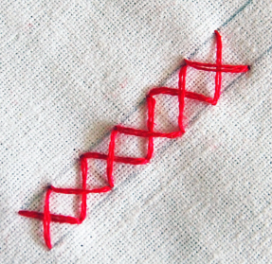
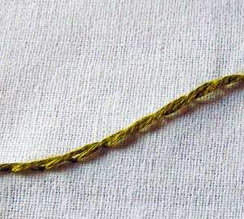
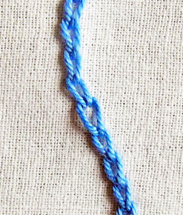
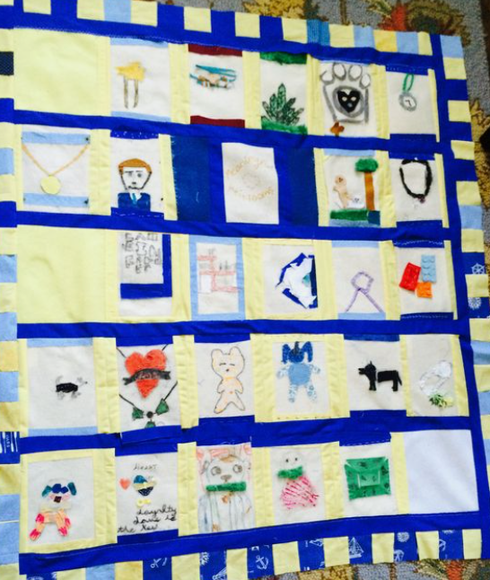
Year 6
Textiles.
DT Knowledge Organiser
Key Knowledge and Skills | Evaluate | Vocabulary
To use the internet for research and design ideas. | How much do existing products cost? | Sew/ Stitch | Join, fasten, or repair by making stitches with a needle and thread or a sewing machine
Use research of the user’s individual needs, wants and requirements for the design.
 | How well do existing products achieve their purpose?
Create your own design criteria and specification.
 |  | Aesthetics | Beauty or art, and people's appreciation of beautiful things.
 | Do they meet the users needs?
Follow and refine a logical plan.
 |  | Functionality | The quality of being suited to serve a purpose well.
Use selected tools and equipment precisely.
 |  | Appliqué | Pieces of fabric are sewn or stuck on to a larger piece to form a picture or pattern.
Accurately measure, mark out, cut and shape materials/components.
Accurately apply a range of finishing techniques. | Is your design fit for purpose?
 |  | Stitch | A loop of thread from a single movement of the needle in sewing, knitting, or crocheting.
 | How well is your product made? What would improve it?
 |  | Cross Stitch | A stitch formed of two stitches crossing each other.
Use techniques that involve a number of steps. | Is the end product like your original design?
 | What did you find a challenge?
 |  | Stem Stitch | Each stitch overlaps the previous stitch to one side, forming a twisted line of stitching, with the thread passing below the needle.
 | Are their any designers who use sustainable materials? What is the impact of this?
 |  | Chain Stitch | A series of looped stitches form a chain-like pattern.
Outcome – To design and make a Class Quilt.
Stem stitch
Chain stitch

