Slide 1
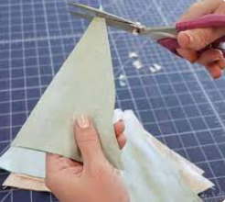
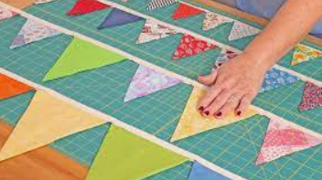
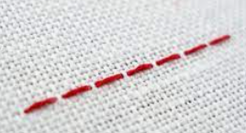
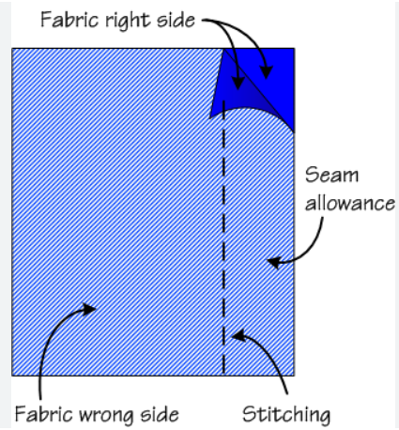
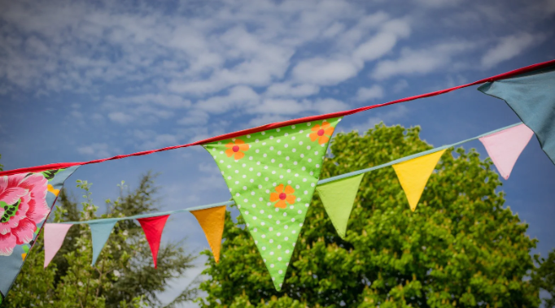
Year 2
Textiles
DT Knowledge Organiser
Key Knowledge and Skills | Evaluate | Vocabulary
To cut out shapes by drawing around a template. | What do you like about the bunting? (Show an existing product) | Fibre | A thread which is formed.
To join the fabric using a running stitch.
 |  | Woven | Interlacing threads or strips of a material woven together.
 | What went well with your design?
To apply decorations such as beads and buttons.
 |  | Cotton | A soft white material.
To apply colour using natural dyes through dipping.
 |  | Thread | A long thin strand of cotton, nylon or other fibres.
 | Would you change anything? Why?
To create fabrics by weaving materials such as ribbons.
Understand the food hygiene procedure after cooking – clean down surfaces, put ingredients away, wash equipment and dry equipment. |  | Needle | A piece of equipment used in sewing where the thread is put through the eye of the needle.
 |  | Running stitch | A line of small even stitches with no overlapping.
To explain what I’m making and why it’s fit for purpose. | What did you find challenging? Why?
Choose suitable materials and explain your choices. |  | Decoration | The process or art of decorating something. To make it look more attractive.
 | Do you like your finished bunting? Is there anything you would change next time?
To use finishing techniques to make the product look good.
 |  | Seam allowance | The area between the fabric edge and the stitching line.
Outcome – To design and
make bunting for the Edible
Playground.

