Slide 1
Welcome to Year Two

Slide 2
TA’s: Mrs Stanger Miss Downie Mrs Young
Classroom Teacher: Mrs Lawrence

Slide 3
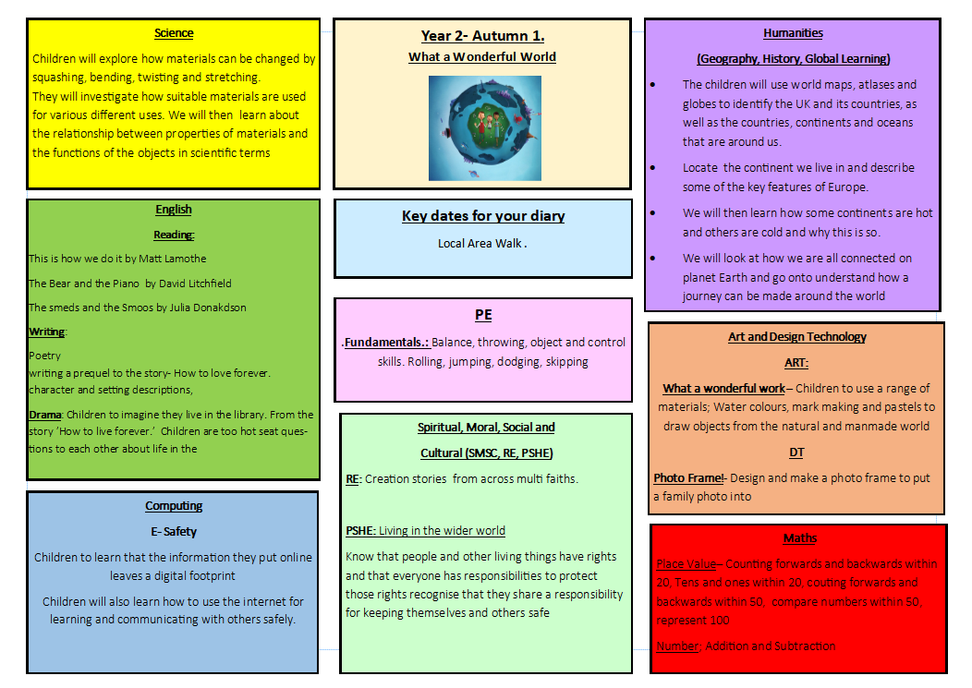

Slide 4
Reading
In Key Stage One we deliver a consistent approach to phonics, called Read Write Inc as this programme will enable us to accelerate the teaching of reading in Early Years and Year One so more focus can be on higher order comprehension and vocabulary in Year Two to meet the demands of the new curriculum and tests.
Every pupil works through the programme to help them decode (sound out) words that they read and spell. Reading is linked into understanding what they have read and also links into writing activities
In Year Two children have a daily Read Write Inc lesson as well as an English lesson.
Your children will have their home reading book changed on a Tuesday and a Thursday. If you listen to your child read please write this in their reading record.
Notes:
Reading book in EVERY day!!!

Slide 5
Opportunities for reading
Pupils also read regularly in other areas of the curriculum and in other parts of the school day through:
•Guided Reading – Teachers work with small groups of pupils to teach specific and targeted reading skills in a book that is sufficiently challenging.
•Reading Across the Curriculum – Pupils read a range of books linked to other areas of their learning and have regular ‘reading journal’ lessons to look at texts in more detail.
•Story Time or class reader time – throughout school books are read to pupils for them to hear good examples of reading aloud and to develop an enthusiasm for reading books themselves. Class books are shared with pupils, where they read along with the teacher.

Slide 6
BOOK AMNESTY!
If you have any school books at home from previous years please bring them into school.
No questions asked!

Slide 7
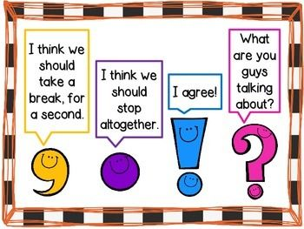
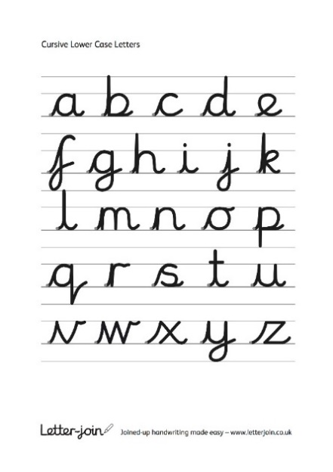
Writing
Grammar skills are taught throughout the year in stand alone grammar lessons which are then threaded through the writing all week.
Weekly writing is usually focused on a high quality text or linked to the topic. We use a range of strategies to engage children in writing including drama, talk for writing and the power of pictures.
We follow the letter join handwriting scheme. This aims to help children achieve the ‘expected’ level at the end of Year 2.
Practice at home will better support your child to develop.
Children are expected to learn their spellings each week and show that they can apply these in their writing. The year 2 common exception works are words children in year 2 should be able to spell and read correctly.

Slide 8
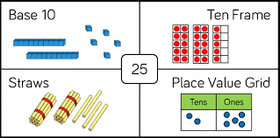
Maths
As a school we follow the white rose scheme in maths.
Children are taught skills progressively and the scheme promotes an enquiry based approach which helps our children build key mathematical skills such as investigation, problem solving and reasoning.
Key skills to practice in Autumn
Partitioning
2,5,10 timetable and division facts
Odd and even numbers
Ordering and sequencing numbers
Representing numbers in different ways

Slide 9
PE
Tuesday Morning
Thursday Afternoon .
Trainers will be needed on a Thursday

Slide 10
Statutory Tests in Year 2
SATs are now called National Curriculum Assessments
They are taken at the end of Key Stage 1 (at age 6/7) and at the end of Key Stage 2 (at age 10/11).
Testing for Year Two takes place during the month of May.
The tests will cover English reading, English grammar, punctuation and spelling, and Mathematics

Slide 11
What level should children be at?
Under the National Curriculum, levels no longer exist.
Children will be teacher assessed and tested according to whether they have achieved all objectives ‘expected’ for their school year.
Teacher assessment overrides any test results!

Slide 12
HOMEWORK
Reading daily- Books will be changed twice a week
Handwriting weekly
Spellings weekly
Handwriting and Spelling homework is set on a Thursday and should be handed in on the following Tuesday
Homework is available to as print if children can not access seesaw.
Notes:
Discuss and show the parents the school website – class blog, homework, class pages, newsletters

Slide 13
How can parents help?
The best help is by taking an interest in your child’s learning and giving lots of positive encouragement.
Attending all meetings and parents evenings.
Supporting by engaging with home learning.
Accessing websites: BBC Bitesize. Education City Phonics Play etc
Not putting children under too much pressure.
Ensuring children arrive for school:
- in good time to start the day
- having had breakfast
- having gone to bed at a reasonable time!
-, book bag
Please collect children on-time or phone ahead if you are late.
Notes:
Please discuss the importance of coming to school on time, they may miss their reading slot. Picking up on time!

Slide 14
What do I do if I need to speak to my child’s teacher?
If you need to speak to a teacher, please phone or email the school office to make a telephone appointment.
Tel: 0191 273 4237,
admin@hawthorn.newcastle.sch.uk

Slide 15
Thank You

