Slide 1
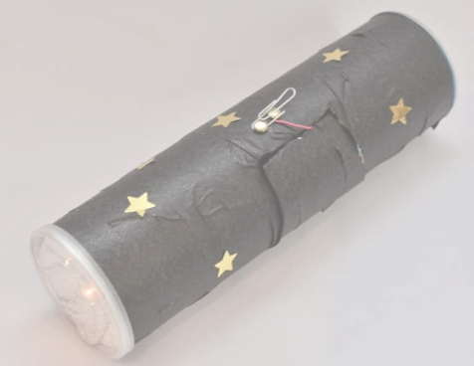
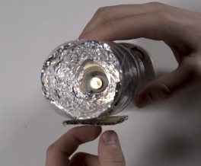
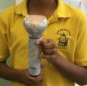
Year 4
Electrical systems.
DT Knowledge Organiser
Key Knowledge | Evaluate | Vocabulary
Explore and investigate different torches. . | Which switch did you use for your torch and why? | Electric circuit | A path that an electric current passes.
Make simple series circuits using batteries, wires, bulbs and switches. |  | Switch | Makes or breaks a circuit.
To investigate different casings for a torch | How did you make the connections secure and was it successful? | Stability | Firmness or the strength to endure lots of use.
Use symbols to draw circuit diagrams to represent and explain electrical circuits in order to plan and modify circuits for a specific function. | Which part of your finished torch are you the happiest with, and why? | Reinforce | To strengthen or support with extra materials.
Design and make switches for a specific use, using card, paper fasteners, wire, drawing pins etc. | Which part of your finished torch would you like to change, and why? | Diagram | A drawing.
Design and evaluate a torch that meets specific design criteria | Do you think your client will be happy with the finished product? Why?
Outcome
To design, make and evaluate a torch with a switch.

