Slide 1
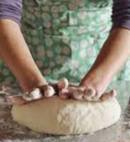
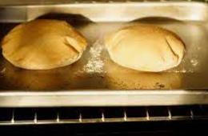
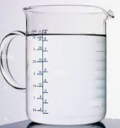
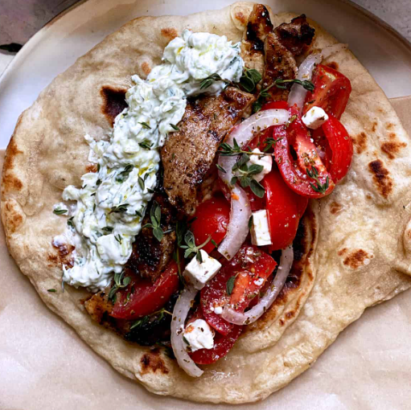
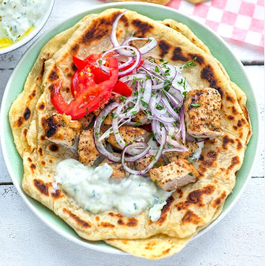
Year 4
Cooking and Nutrition.
DT Knowledge Organiser
Key Knowledge and Skills | Evaluate | Vocabulary
Develop their own design criteria and use these to inform their idea. | What do you like about the Greek pita? How well has it been made? What materials have been used? Is it fit for purpose? (Show an existing product) | Food Group | Foods placed in different categories such as proteins and carbohydrates.
Make design decisions that take account of the availability of resources.
 |  | Balanced Diet | A diet consisting of a variety of different types of food.
 | What went well with your product design? Did it look like it at the end after you’d made your Greek pita?
To use annotated drawings to communicate their ideas.
 |  | Measuring | To measure out the required amount for a given food or drink.
Order the main stages of making.
 |  | Baking | Cooking food using heat, usually in an oven.
 | Why did you choose those ingredients?
That to be active and healthy, food and drink are needed to provide energy for the body.
Understand the food hygiene procedure after cooking – clean down surfaces, put ingredients away, wash equipment and dry equipment. |  | Kneading | Using our hands to knead flour and water into a dough.
 |  | Import | Bring (goods or services) into a country from abroad for sale.
That food ingredients can be fresh, pre-cooked and processed. | How would you improve your original design?
How to use techniques such as kneading and baking. |  | Export | Send (goods or services) to another country for sale.
 | What did you find challenging? Why?
When we trade in foods from another country it is called importing. When we trade out foods to another country It is called exporting.
 |  | Traditional Dish | Traditional foods are foods and dishes that are passed on through generations.
Outcome – To design and make a flavoured Greek pita bread.

